Slide 1
Probability and Bayes Theorem Biology 683 Lecture 3 Heath Blackmon

Slide 2
Last week
What is the difference in a population and a sample?
What is the difference in a parameter and a statistic?
How does the central limit theorem help us?

Slide 3
Today
Probability
Introduction to Bayes

Slide 4
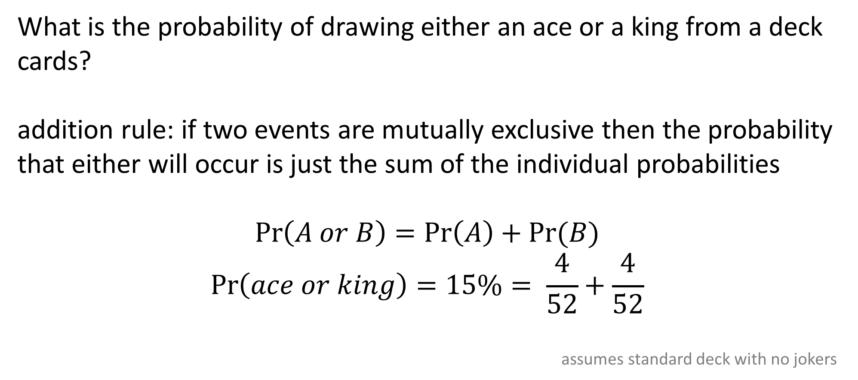
Mutually exclusive events
What is the probability of drawing either an ace or a king from a deck cards?
addition rule: if two events are mutually exclusive then the probability that either will occur is just the sum of the individual probabilities
$$\operatorname{Pr}\left(A or B\right)=\operatorname{Pr}\left(A\right)+Pr⁡(B)$$
$$\operatorname{Pr}\left(ace or king\right)=15\%= \frac{4}{52}+\frac{4}{52}$$
assumes standard deck with no jokers

Slide 5
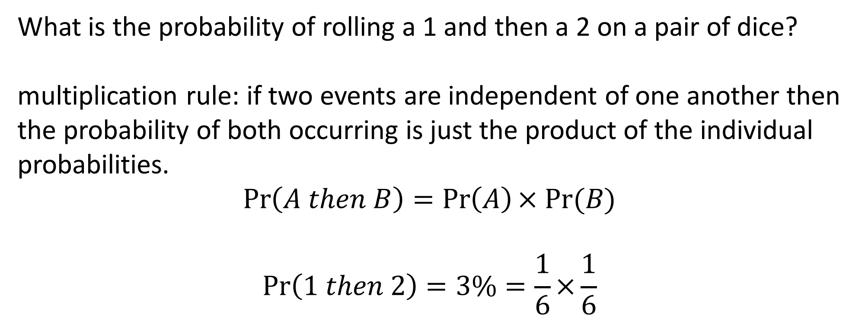
Independent events
What is the probability of rolling a 1 and then a 2 on a pair of dice?
multiplication rule: if two events are independent of one another then the probability of both occurring is just the product of the individual probabilities.
$$\operatorname{Pr}\left(A then B\right)=\operatorname{Pr}\left(A\right)× Pr⁡(B)$$
$$\operatorname{Pr}\left(1 then 2\right)=3\%=\frac{1}{6}×\frac{1}{6}$$

Slide 6
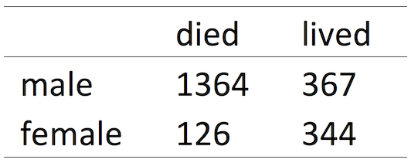
Non-independence
non-independent events- conditional probability: is the probability of an event given that another event has already occurred.
For instance, the probability of surviving the sinking of the Titanic was very different than the probability of surviving if you were a female

Slide 7
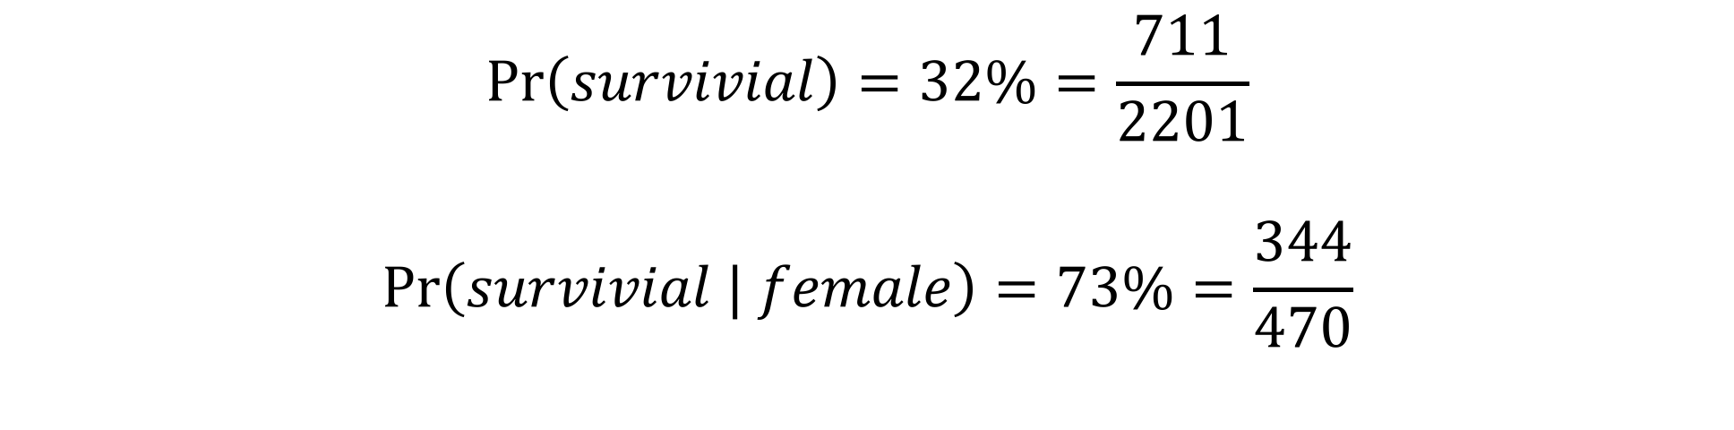
Conditional probability
$$\operatorname{Pr}\left(survivial\right)=32\%=\frac{711}{2201}$$
$$\operatorname{Pr}\left(survivial | female\right)=73\%=\frac{344}{470}$$

Slide 8
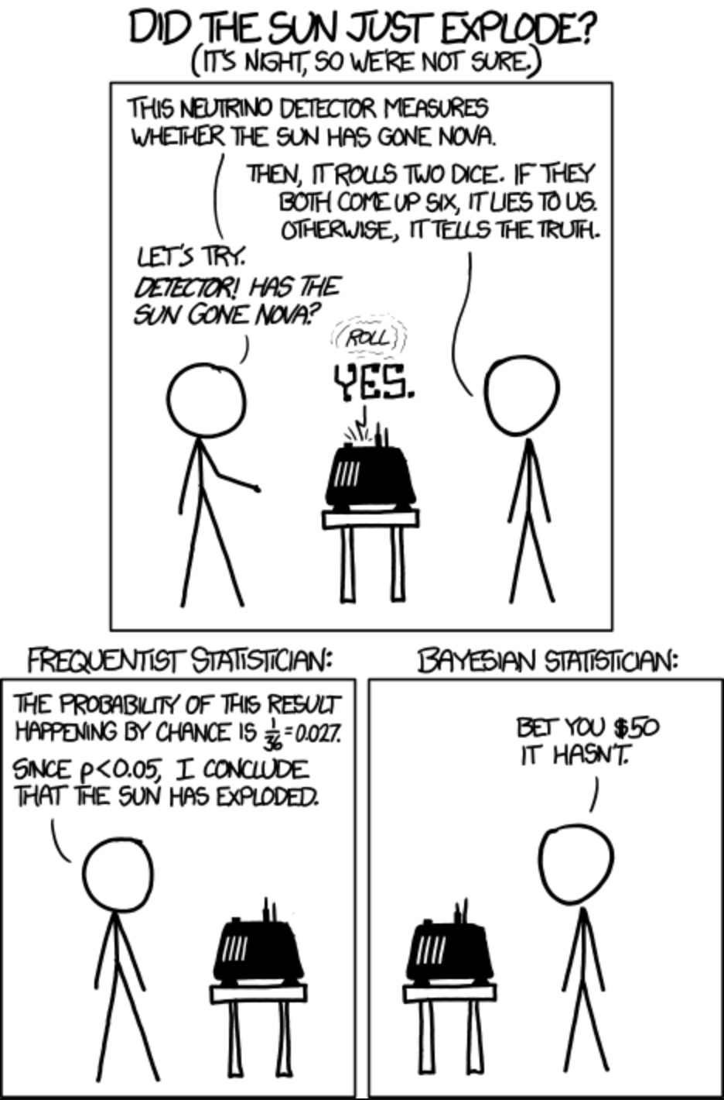
Frequentist and Bayesian

Slide 9
Frequentist and Bayesian
 | Frequentist | Bayesian
Hypothesis test | P-value | Bayes factors
Parameter estimation | Maximum likelihood with confidence interval | Posterior distribution

Slide 10
Frequentist and Bayesian
 | Frequentist | Bayesian
Hypothesis test | P-value | Bayes factors
Parameter estimation | Maximum likelihood with confidence interval | Posterior distribution

Slide 11
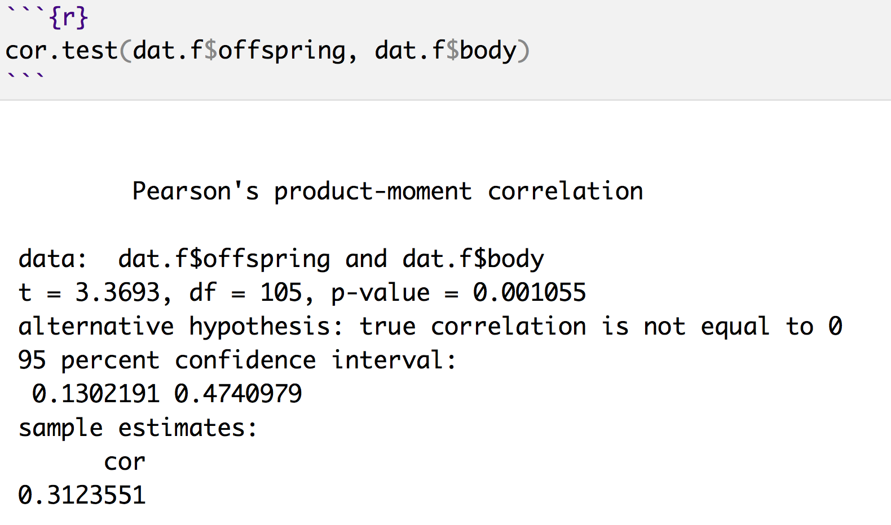
What is a p-value?
Is the probability of finding the observed, or more extreme, results when the null hypothesis is true.

Slide 12
Frequentist and Bayesian
 | Frequentist | Bayesian
Hypothesis test | P-value | Bayes factors
Parameter estimation | Maximum likelihood with confidence interval | Posterior distribution

Slide 13
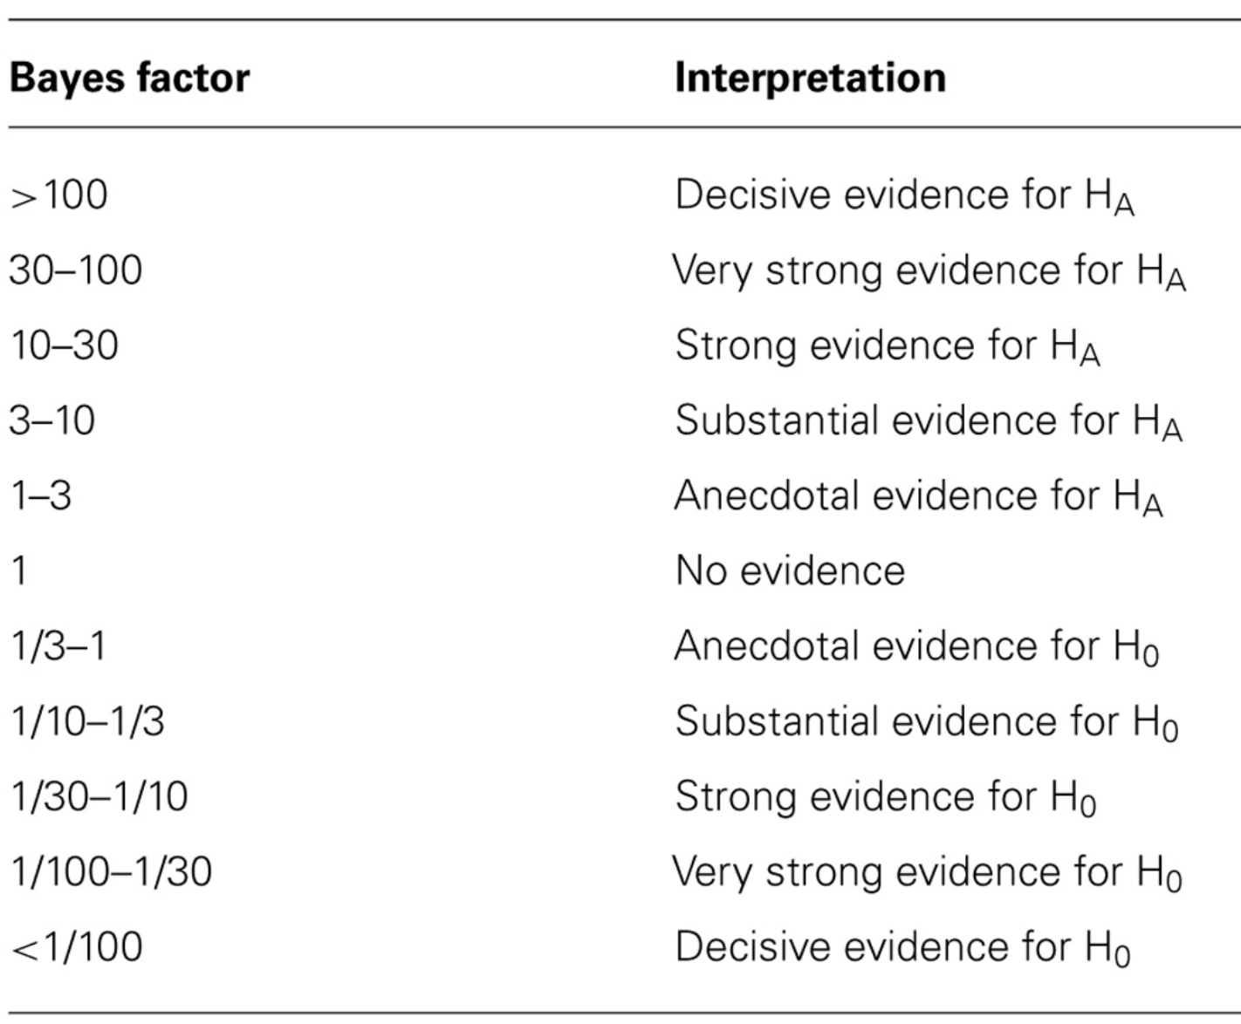
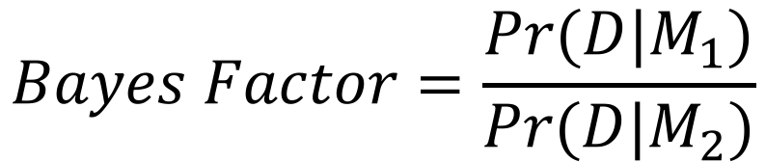
Frequentist and Bayesian
$$Bayes Factor=\frac{Pr⁡(D|M_{1})}{Pr⁡(D|M_{2})}$$

Slide 14
Frequentist and Bayesian
 | Frequentist | Bayesian
Hypothesis test | P-value | Bayes factors
Parameter estimation | Maximum likelihood with confidence interval | Posterior distribution

Slide 15
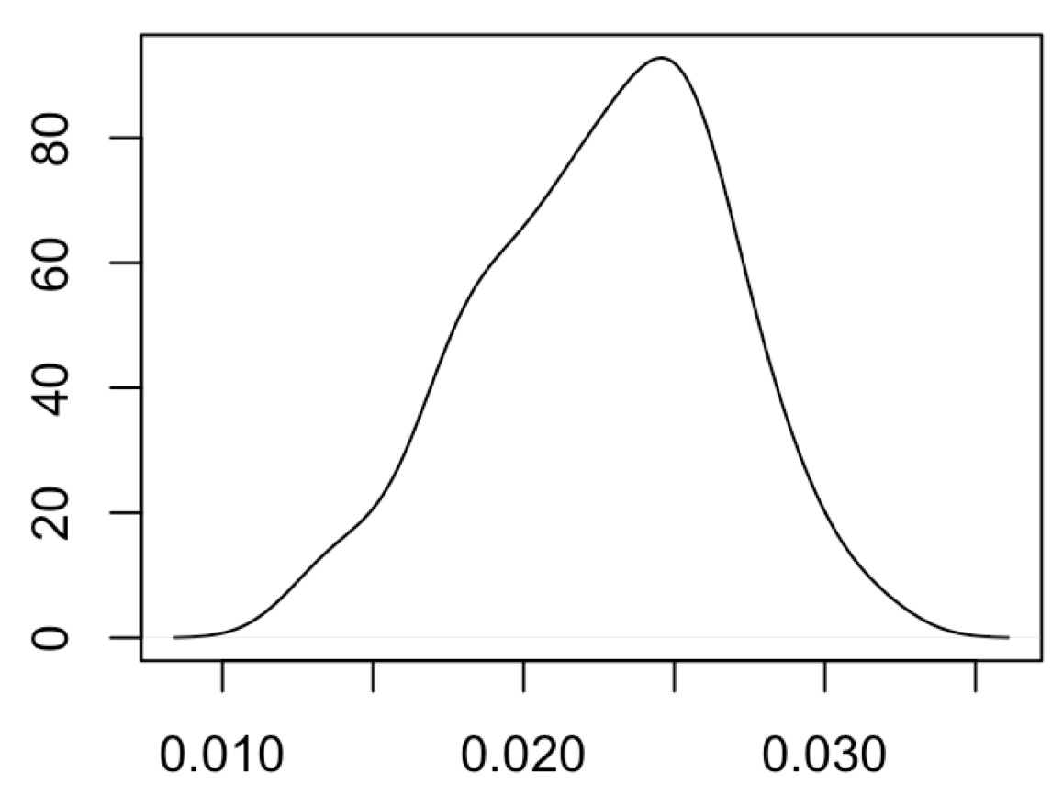
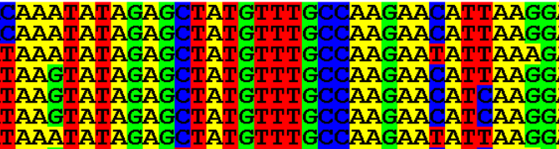
Frequentist parameter estimate
Everything is fixed except parameter of interest. Shape of likelihood determines estimate of the statistic
 | A | G | C | T
A |  | β | ⍺ | ⍺
G | β |  | ⍺ | ⍺
C | ⍺ | ⍺ |  | β
T | ⍺ | ⍺ | β
Pr(data)
Parameter values

Slide 16
Frequentist and Bayesian
 | Frequentist | Bayesian
Hypothesis test | P-value | Bayes factors
Parameter estimation | Maximum likelihood with confidence interval | Posterior distribution

Slide 17
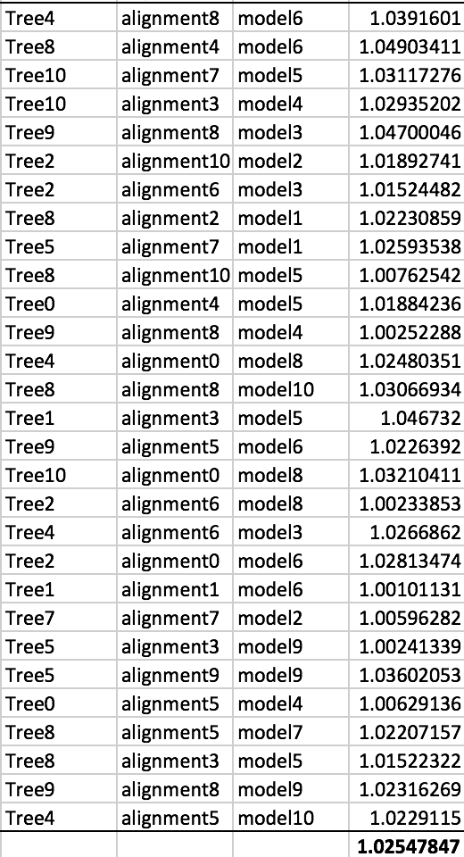
Bayesian parameter estimate
We create a marginal estimate of the statistic of interest
 | A | G | C | T
A |  | β | ⍺ | ⍺
G | β |  | ⍺ | ⍺
C | ⍺ | ⍺ |  | β
T | ⍺ | ⍺ | β
 | A | G | C | T
A |  | ⍺ | ⍺ | ⍺
G | ⍺ |  | ⍺ | ⍺
C | ⍺ | ⍺ |  | ⍺
T | ⍺ | ⍺ | ⍺

Slide 18
Frequentist and Bayesian

Slide 19
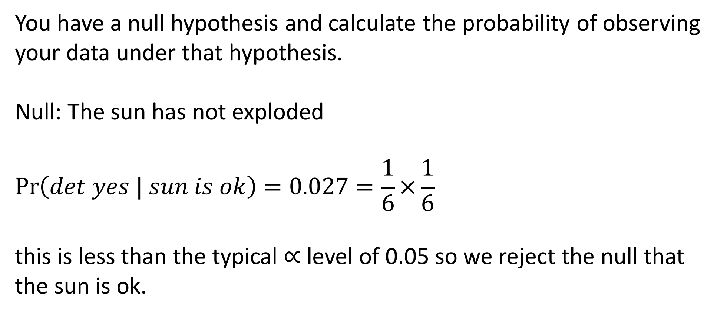
Frequentist approach
You have a null hypothesis and calculate the probability of observing your data under that hypothesis.
Null: The sun has not exploded
$$\operatorname{Pr}\left(det yes | sun is ok\right)=0.027=\frac{1}{6}×\frac{1}{6}$$
this is less than the typical $∝$ level of 0.05 so we reject the null that the sun is ok.

Slide 20
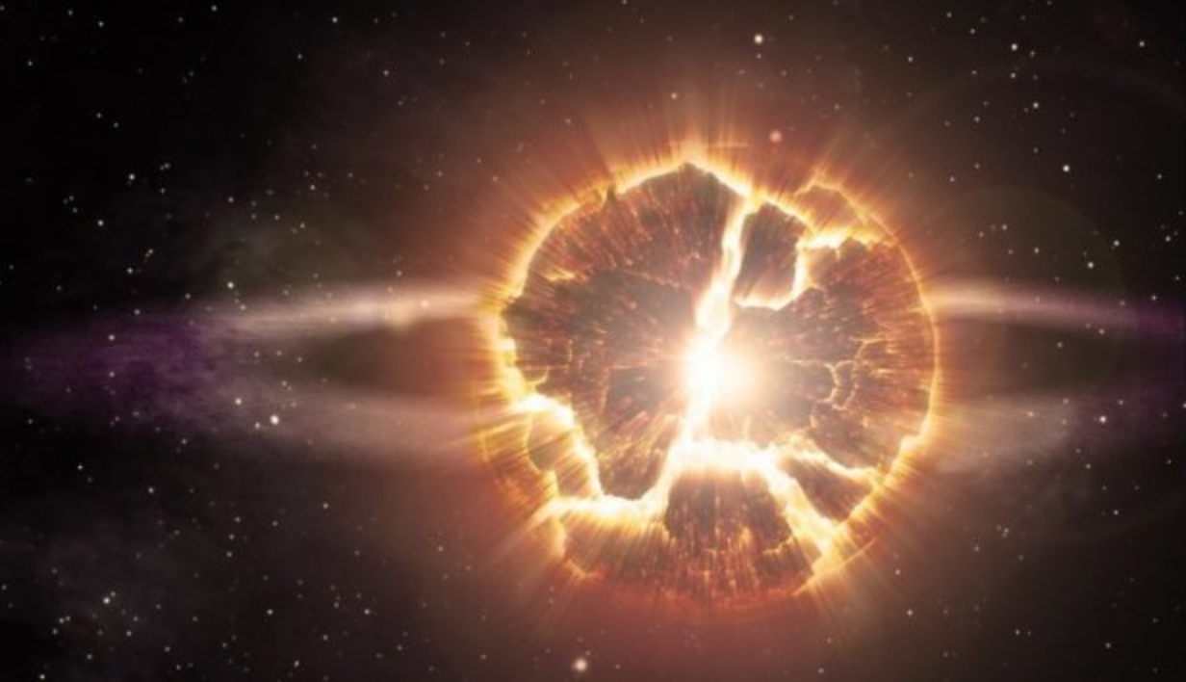
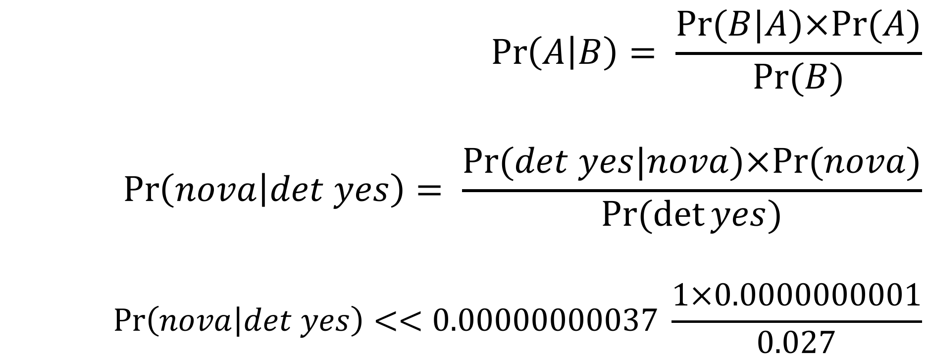
Bayesian approach
$$\operatorname{Pr}\left(A | B\right)= \frac{Pr⁡(B|A)×Pr⁡(A)}{Pr⁡(B)}$$
$$\operatorname{Pr}\left(nova | det yes\right)= \frac{Pr⁡(det yes|nova)×Pr⁡(nova)}{Pr⁡(\det{yes})}$$
$$\operatorname{Pr}\left(nova | det yes\right)<<0.00000000037 \frac{1×0.0000000001}{0.027}$$

Slide 21
Bayesian approach
Imagine a genetic mutation present in 1 person per 100,000. If you take a test that correctly returns a positive result 99.9% of the time when someone is infected but has a false positive rate of 0.5%.
How likely are you to have the disease?
Should you be concerned?
Bayes’ theorem provides a natural way to think about this.

Slide 22
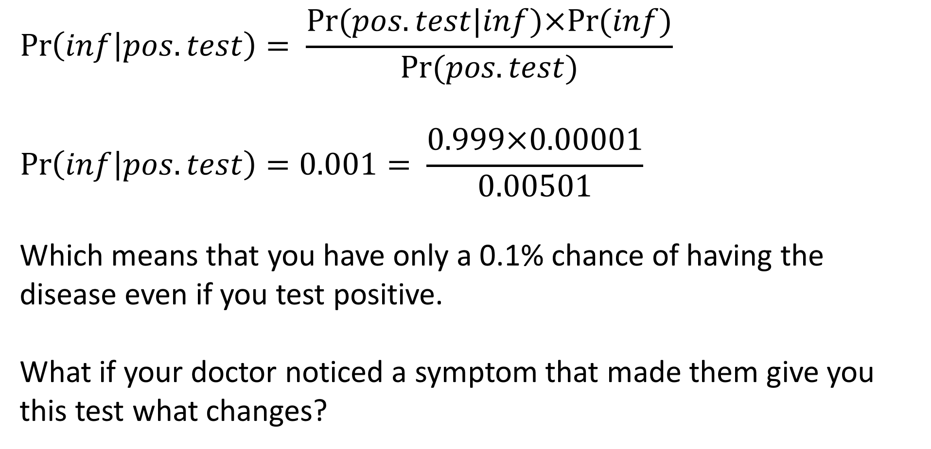
Bayesian approach
$$\operatorname{Pr}\left(inf | pos.test\right)= \frac{Pr⁡(pos.test|inf)×Pr⁡(inf)}{Pr⁡(pos.test)}$$
$$\operatorname{Pr}\left(inf | pos.test\right)=0.001= \frac{0.999×0.00001}{0.00501}$$
Which means that you have only a 0.1% chance of having the disease even if you test positive.
What if your doctor noticed a symptom that made them give you this test what changes?

Slide 23
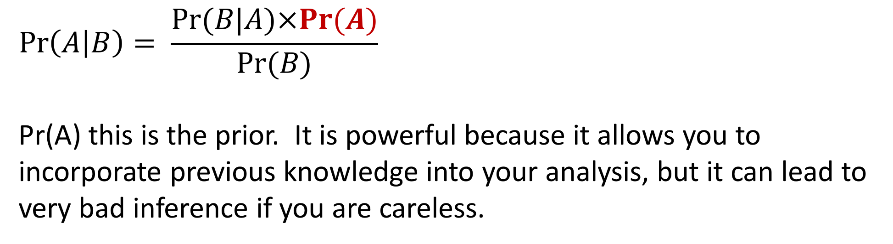
Priors
$$\operatorname{Pr}\left(A | B\right)= \frac{Pr⁡(B|A)×Pr⁡(A)}{Pr⁡(B)}$$
Pr(A) this is the prior. It is powerful because it allows you to incorporate previous knowledge into your analysis, but it can lead to very bad inference if you are careless.

Slide 24
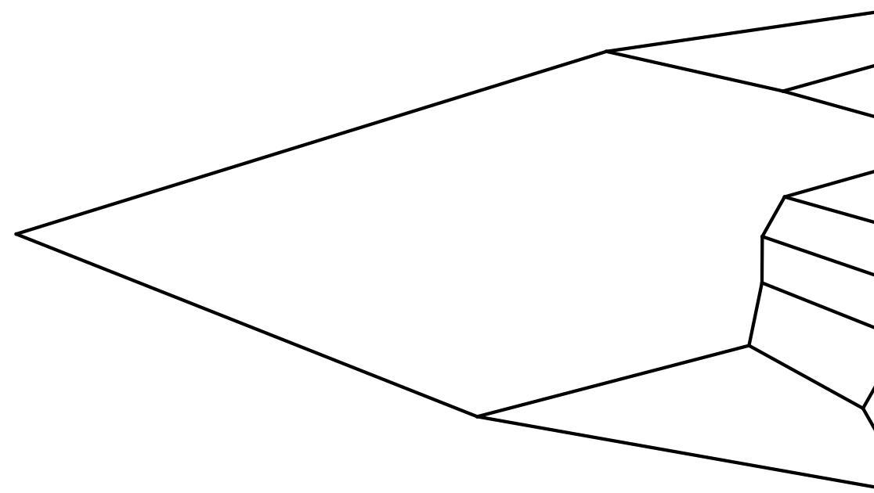
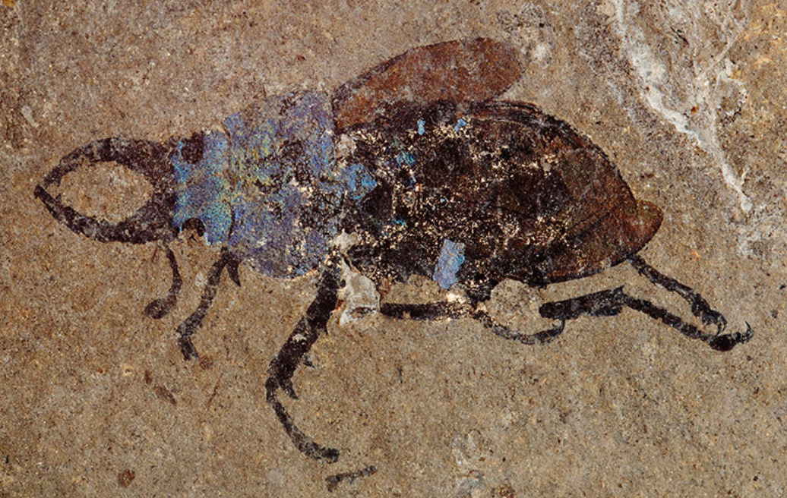
Fossils as Priors
When we use DNA to infer the relationship of extant species we can use fossils to tell us how long ago a group of organisms existed.
If my fossil 65 MY old then the node in red must be at least 65 MY old as well.

Slide 25
The prior by itself

Slide 26
Compare the prior and the posterior

Slide 27
Less informative prior

Slide 28
Posterior is not constrained by prior

Slide 29
The rise of Bayesian approaches
Since the 1990s Bayesian approaches have come to the forefront in phylogenetics, population genetics, genomics, ecology, and other fields. This largely because we now have the computational power to use MCMCs to sample posterior distributions...

Slide 30
The power of Bayesian approaches
With a Bayesian approach we can take into account all types of uncertainty and be more conservative.
Phylogenetic
Model selection uncertainty
Parameter value uncertainty
Uncertainty in measurements

Slide 31
For Thursday
Read chapter WS 5 and chapter 2 of McElreath
Bring laptop to class!
Heath Blackmon
BSBW 309
coleoguy@gmail.com
@coleoguy

Slide 32
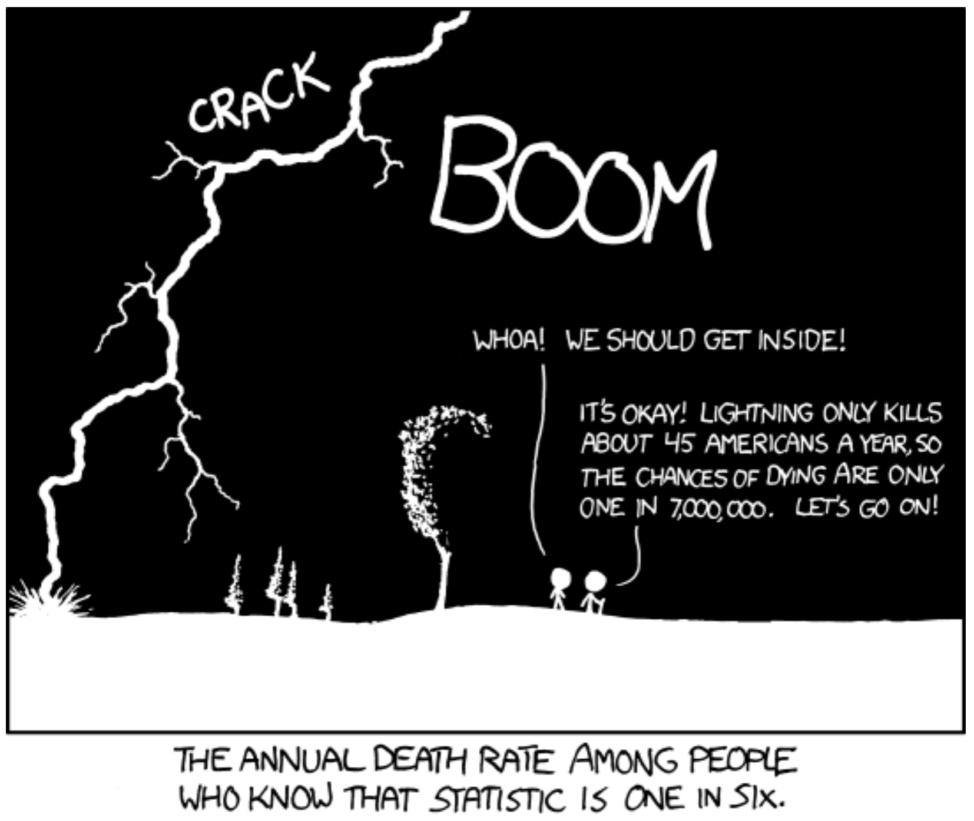
Setting matters

